Slide 1


R Best Practices
MPhil Population Health Sciences | Advanced Biostatistics for Epidemiology
MPhil Population Health Sciences | Advanced Biostatistics for Epidemiology
Robert Fletcher | raf69@medschl.cam.ac.uk

Slide 2



Project Organisation
Code Organisation and Styling
Reproducibility
MPhil Population Health Sciences | Advanced Biostatistics for Epidemiology
Robert Fletcher | raf69@medschl.cam.ac.uk

Slide 3
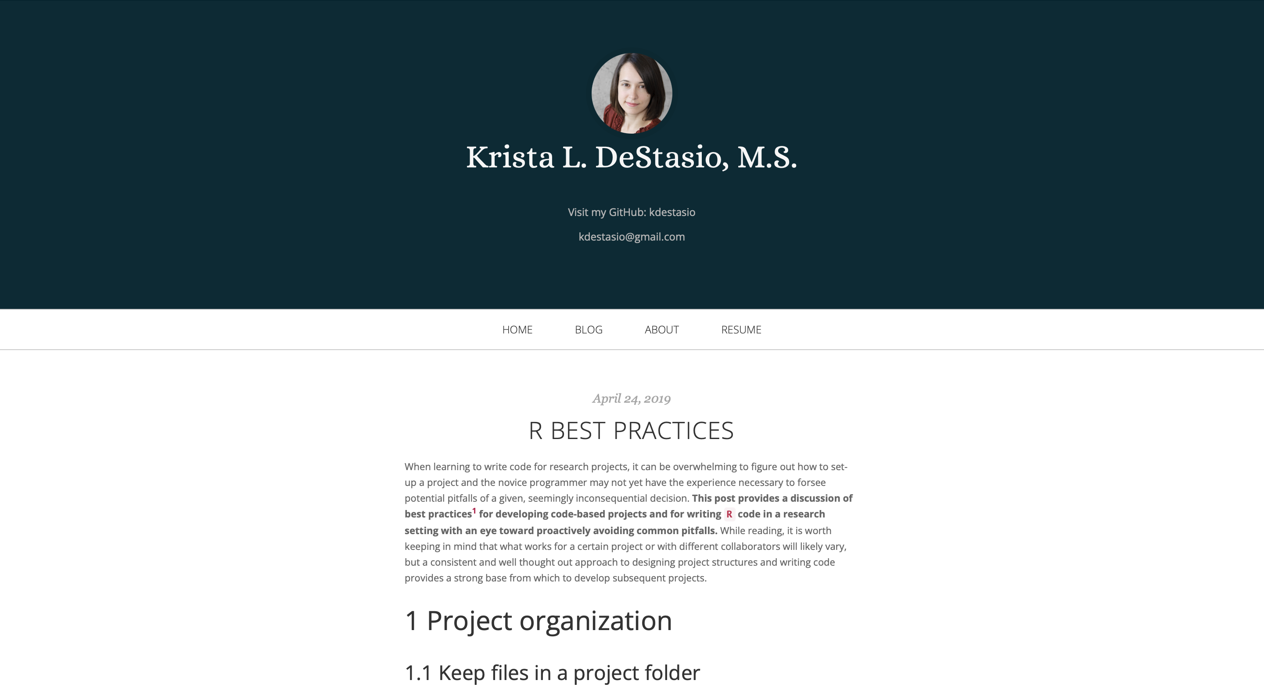
Project Organisation
https://kdestasio.github.io/post/r_best_practices/
MPhil Population Health Sciences | Advanced Biostatistics for Epidemiology
Robert Fletcher | raf69@medschl.cam.ac.uk

Slide 4
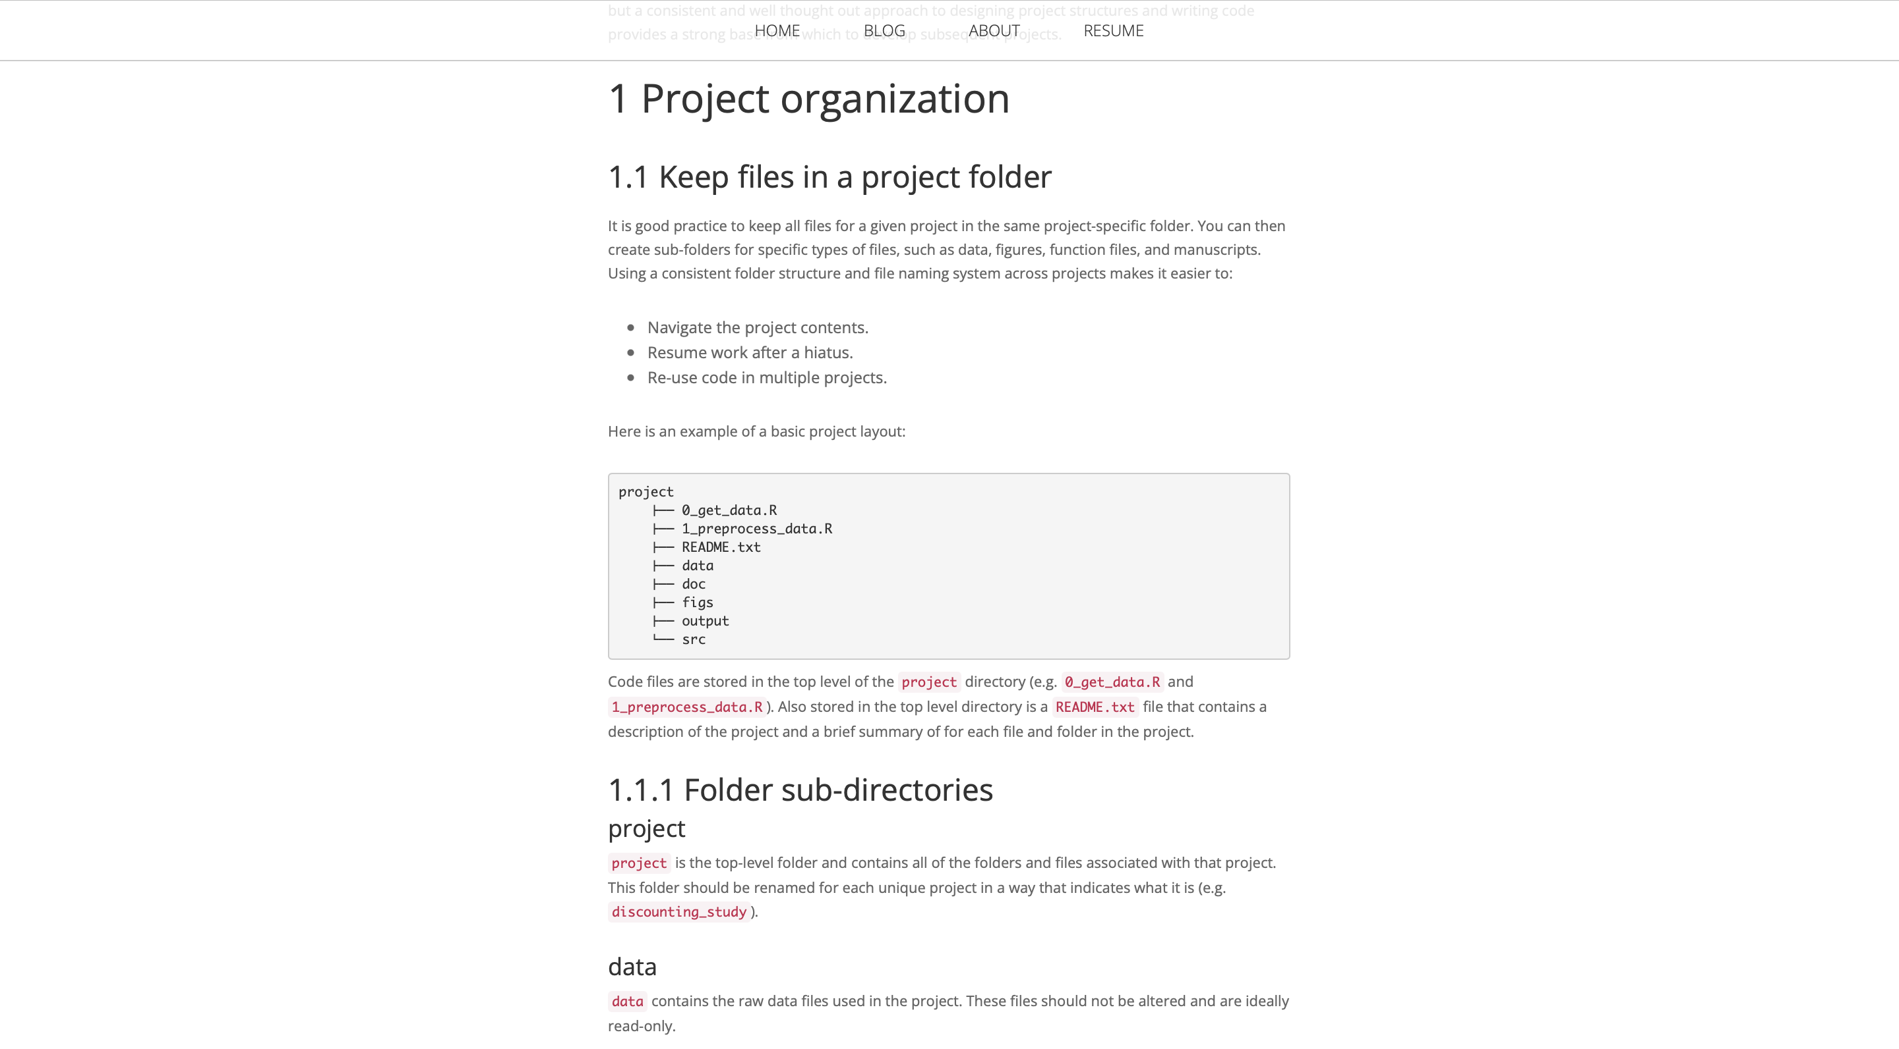
Project Organisation
https://kdestasio.github.io/post/r_best_practices/
MPhil Population Health Sciences | Advanced Biostatistics for Epidemiology
Robert Fletcher | raf69@medschl.cam.ac.uk

Slide 5
Project Organisation
project
├── README.md
├── code
├── data
├── doc
├── figs
├── src
└── output
README.md
data
1
Contains a description of the project and a brief summary of for each file and folder in the project.
3
Contains the raw data files used in the project. These files should not be altered and are ideally read-only.
code
doc
2
Contains analysis code, numbered sequentially:
01_prepare_raw_data.R
02_prepare_baseline.R
4
Contains any manuscripts or interim summaries produced with the project.
MPhil Population Health Sciences | Advanced Biostatistics for Epidemiology
Robert Fletcher | raf69@medschl.cam.ac.uk

Slide 6
Project Organisation
project
├── README.md
├── code
├── data
├── doc
├── figs
├── src
└── output
figs
output
5
Contains any plots, images, tables, or figures created and saved by your code. It should be possible to delete and regenerate this folder with the scripts in the project folder.
7
Contains non-figure objects created by the scripts. For example, processed data or logs.
6
src
An optional folder for any files you may want to source() in your scripts. This is not code that is run. For example, simple .R files containing functions.
MPhil Population Health Sciences | Advanced Biostatistics for Epidemiology
Robert Fletcher | raf69@medschl.cam.ac.uk

Slide 7
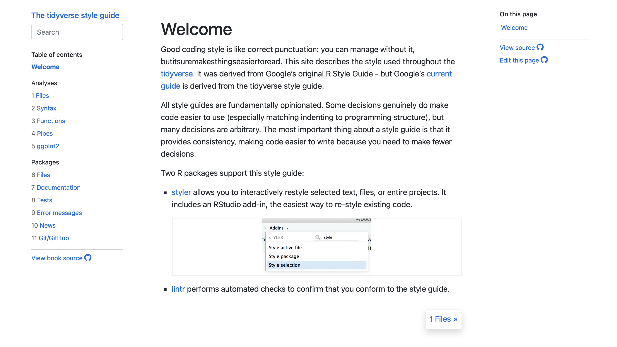
Code Organisation and Styling
https://style.tidyverse.org/index.html
MPhil Population Health Sciences | Advanced Biostatistics for Epidemiology
Robert Fletcher | raf69@medschl.cam.ac.uk

Slide 8
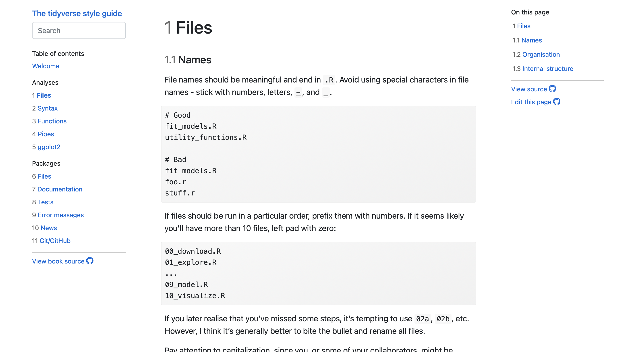
Code Organisation and Styling
https://style.tidyverse.org/index.html
MPhil Population Health Sciences | Advanced Biostatistics for Epidemiology
Robert Fletcher | raf69@medschl.cam.ac.uk

Slide 9
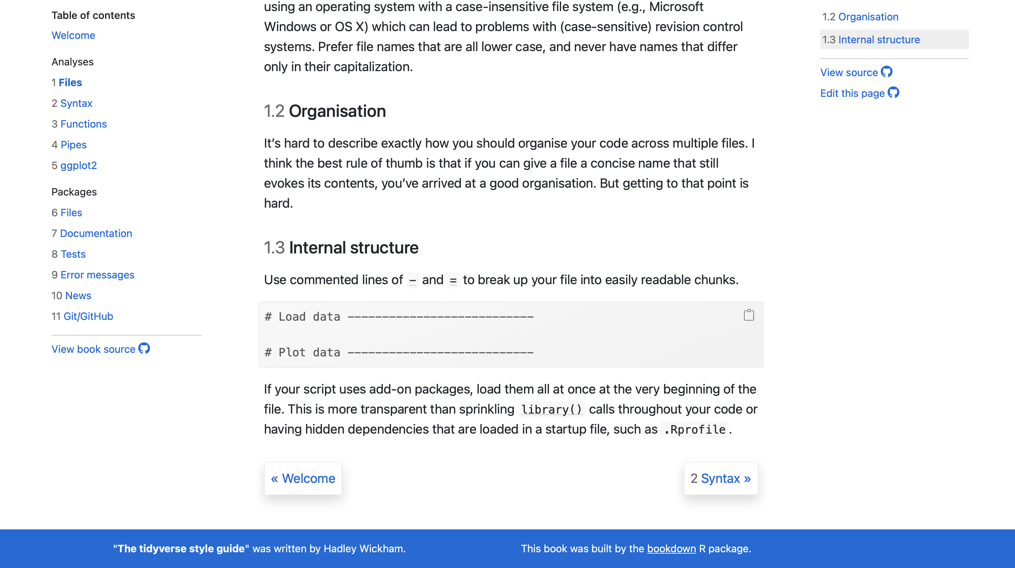
Code Organisation and Styling
https://style.tidyverse.org/index.html
MPhil Population Health Sciences | Advanced Biostatistics for Epidemiology
Robert Fletcher | raf69@medschl.cam.ac.uk

Slide 10
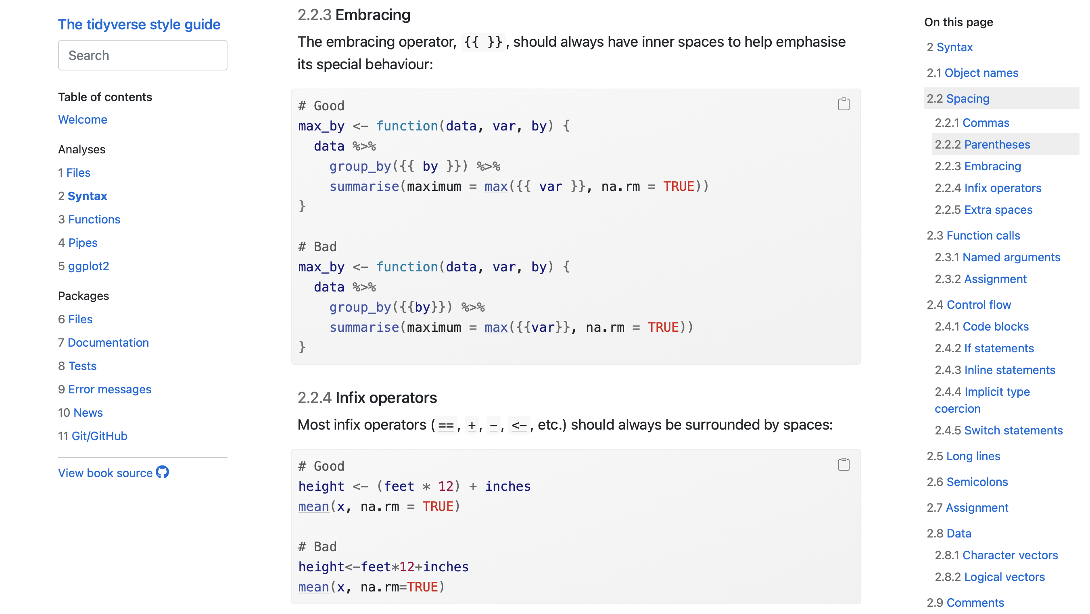
Code Organisation and Styling
https://style.tidyverse.org/index.html
MPhil Population Health Sciences | Advanced Biostatistics for Epidemiology
Robert Fletcher | raf69@medschl.cam.ac.uk

Slide 11
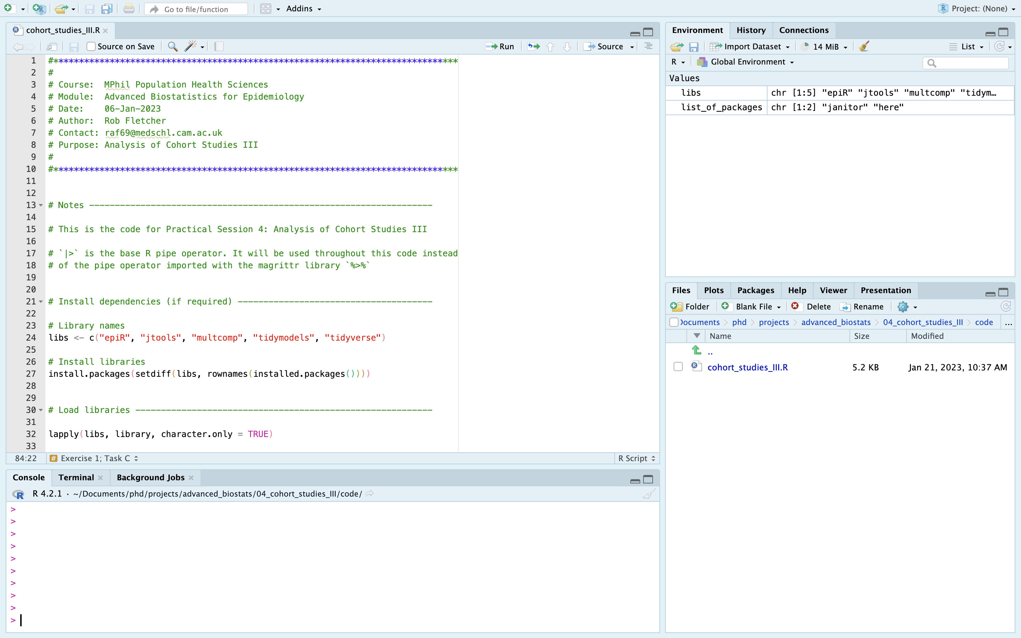
Code Organisation and Styling
MPhil Population Health Sciences | Advanced Biostatistics for Epidemiology
Robert Fletcher | raf69@medschl.cam.ac.uk

Slide 12
Reproducibility
Avoid setwd() and rm(list = ls())
Use RStudio projects instead, and regularly restart your session
Don’t save your workspace
Start each session with a clean environment. To turn this off:
Go to RStudio > Preferences...
Uncheck the box for "Restore .RData into workspace at setup".
Set "Save workspace to .RData on exit" to "Never".
Use GitHub for version control and code dissemination
MPhil Population Health Sciences | Advanced Biostatistics for Epidemiology
Robert Fletcher | raf69@medschl.cam.ac.uk

